Slide 1

The Battle of Neighborhoods Los Angeles, California
Wimala Paramastri

Slide 2
Introduction
California, the 3rd most populous state in USA
Los Angeles, the most populous county in USA, having around 4 million residents, 3rd largest metropolitan economy in the world, famous for its entertainment industry
Why Gym?
Los Angeles is famous for people who is pursuing career in entertainment industry, which makes it important for them to take care of their body, beauty, and health
Where to open Gym?
Good residential location
Urban neighborhood characteristic
Big enough population
Less nearby competitors
Have supportive common venues

Slide 3
Data
Name of region and neighborhoods
Source: latimes.com
Number of residents (population)
Source: latimes.com
Common venues around every city
Source: Foursquare
Location of neighborhoods (Langitude and Latitude)
Source: geocoders and latimes.com

Slide 4
Methodology
importing all data and merging into a main dataframe → using beautifulsoup, json request, geocoders, and foursquare API
Collect all 272 name of neighborhoods around LA, get number of residents data for all neighborhoods, location (by latitude and longitude), and venues around every neighborhoods from sources
rank common venues around every city for analyzing neighborhood characteristic → using kMeans clustering method
group all venues, count each venue appearances in every neighborhood by one hot encoding and the count mean of each venue categories. Rank the means and turn it into a dataframe. Cluster all the neighborhoods by the common venues using kMeans=5
check potential neighborhood by gym competitor nearby → using foursquare API
check locations of another gym (business competitor) within 3 kms from neighborhood’s center

Slide 5
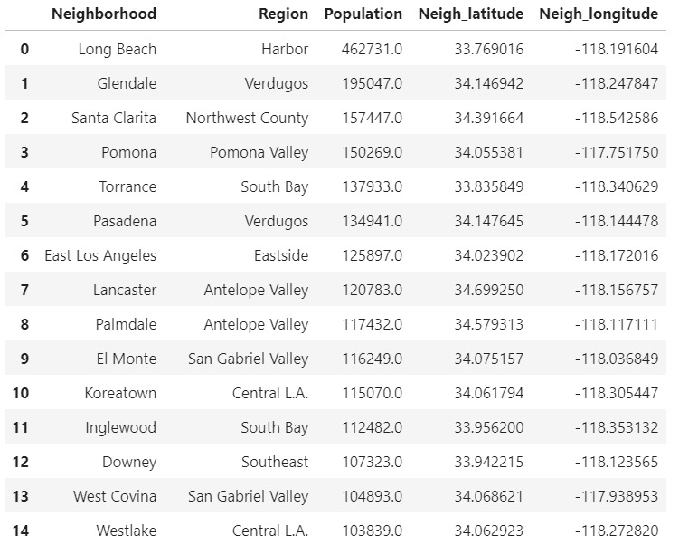
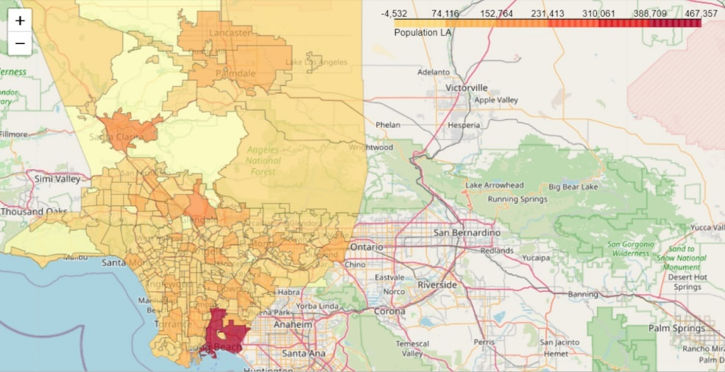
Analysis
Main data imported from sources
Getting a total of 260 data of neighborhood after dropping empty data
Checking map with each number of populations

Slide 6
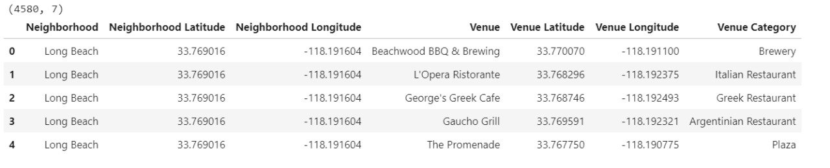
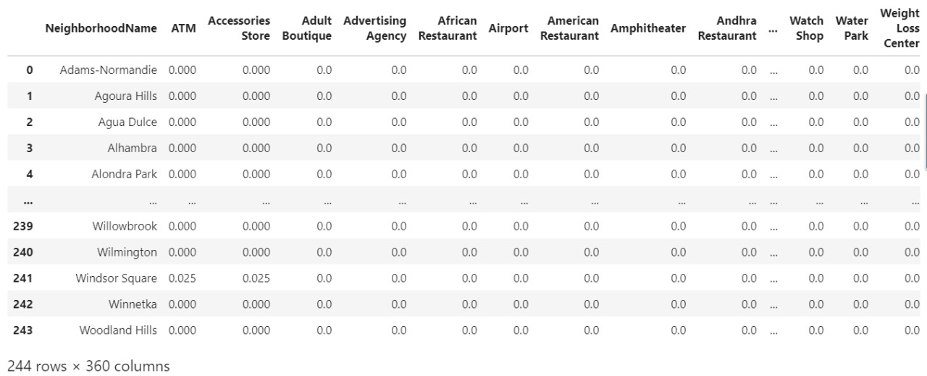
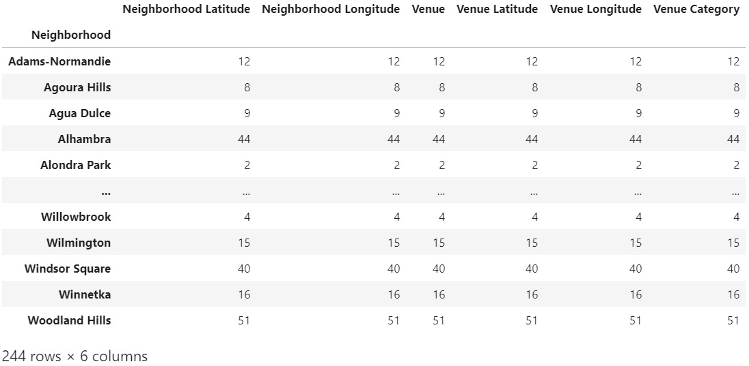
Get all 4580 venues near each neighborhood with 244 total categories
Group by neighborhood name, use one hot encoding, count the mean of every venue categories appearance in each neighborhood and then sort it from the 1st until 10th highest

Slide 7
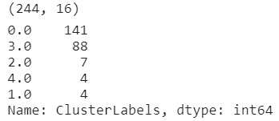
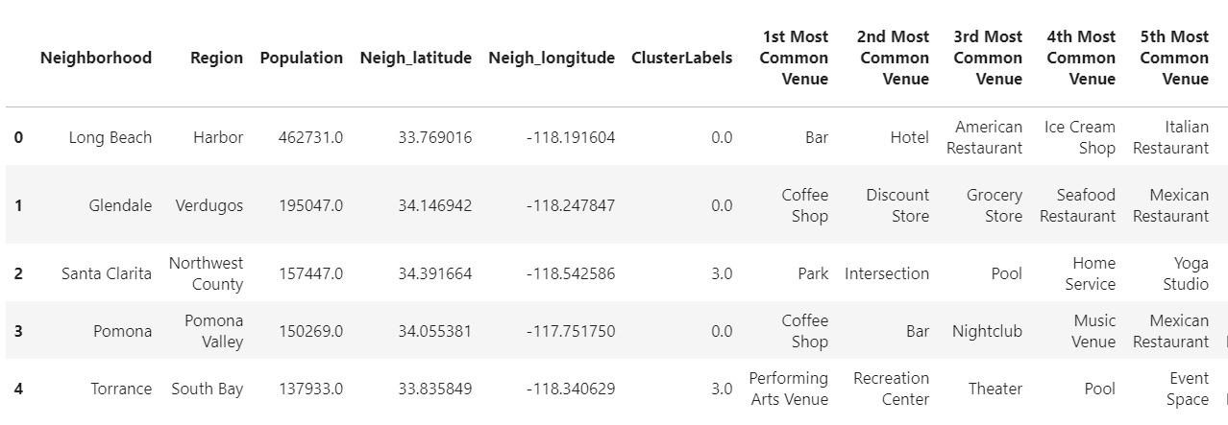
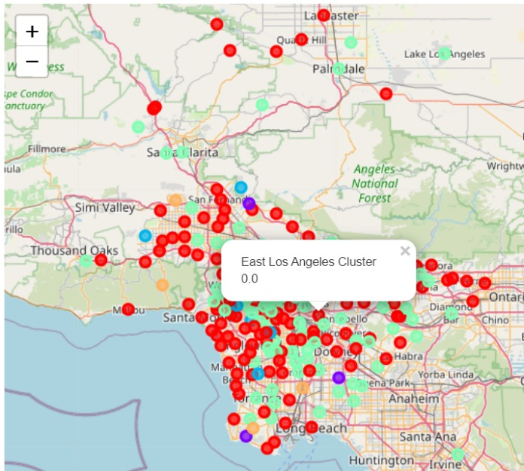
Cluster using kMeans=5, merge into main dataframe, checking by the LA map
Taking 3 biggest clusters to analyze: cluster 1, cluster 3 and cluster 4

Slide 8
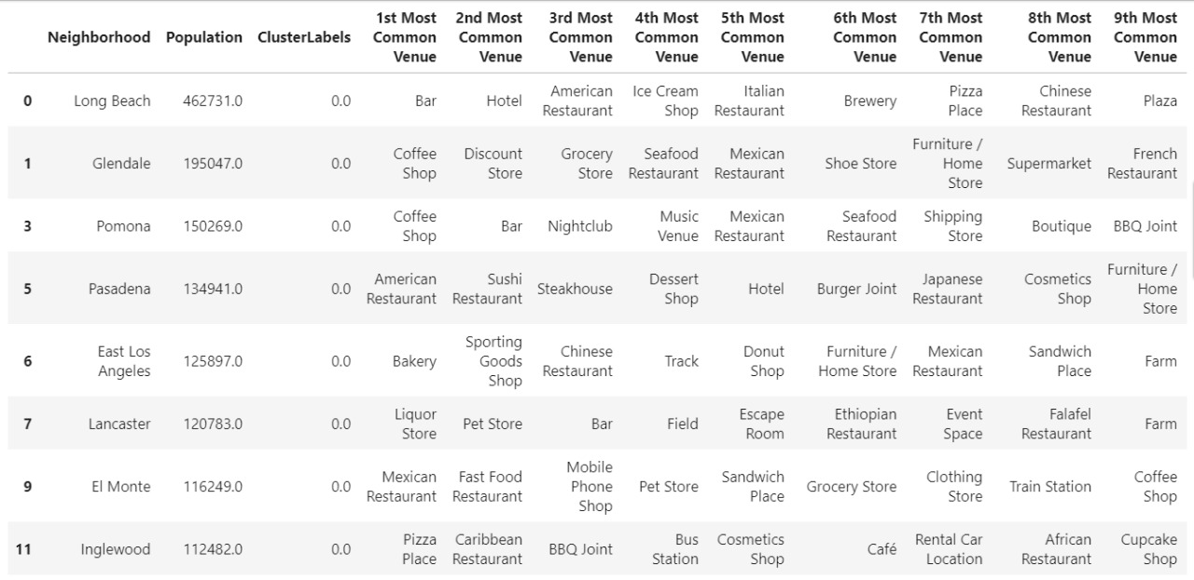
Cluster 1
Big neighborhood with the most population among other cluster
Various choice of restaurants as its common venue
Lots of good place for socializing, for fun and entertainment Various kind of place to enjoy food/drink/snack, various places to shop
Typical urban core neighborhood with a complete and diverse facilities

Slide 9
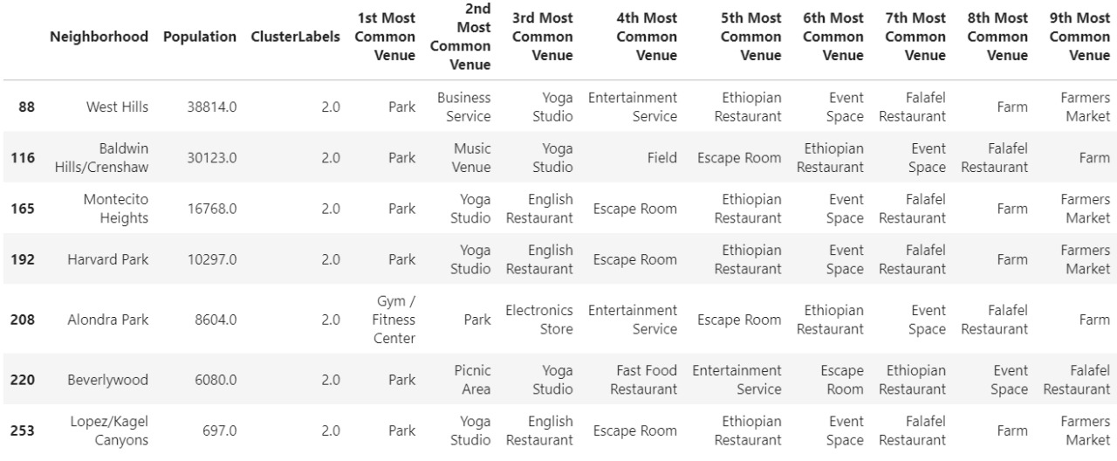
Cluster 3
Place for various activities outdoor, main venues are parks
Have only some type of restaurants
Good place for relaxing by doing yoga
Have some entertainment venues and farm
A suburban neighborhood

Slide 10
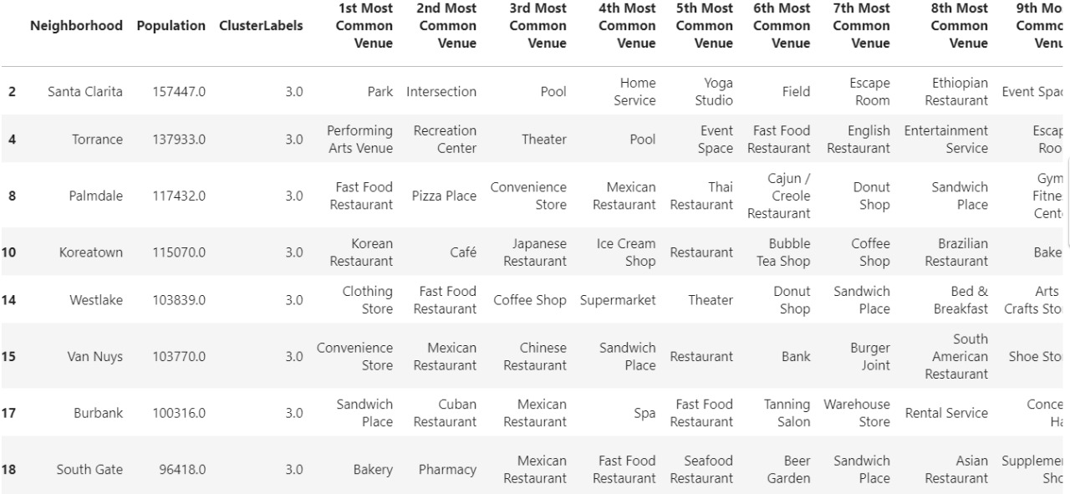
Cluster 4
Similar to cluster 1, has a lot of various restaurant except dominated with fast food
Lot of venues for activity
Lots of place to shop daily needs (market)
A type of residential neighborhood that is good for living

Slide 11
Where to open Gym?
Cluster 1
It is important to open Gym at a good residential type of neighborhood like cluster 4 BUT it is also important to target correct market that will going to use the gym service
Cluster 1 is an urban core neighborhood →has a lot of people reside, fit our target (people who would like to pursue career in entertainment industry), have enough number of population
East Los Angeles

Slide 12
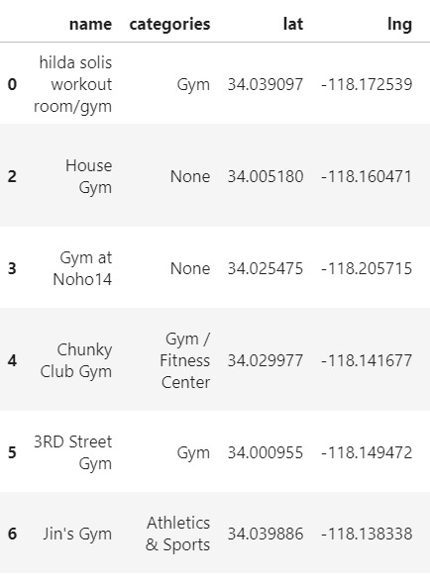
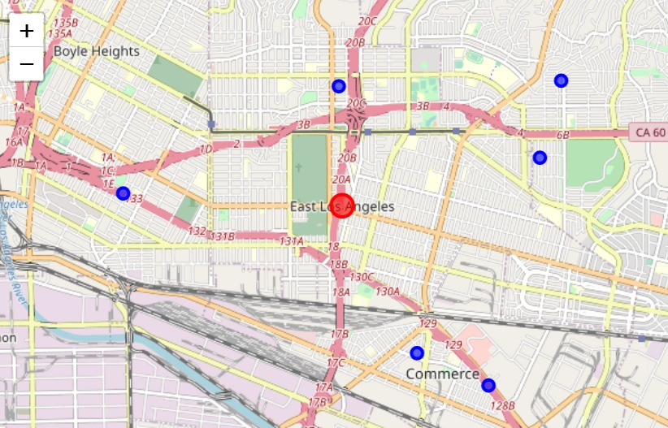
East Los Angeles
Choosing East Los Angeles as a recommended place to open Gym
Has big enough population among its cluster
Has a lot of common facilities/venues in line with health caring such as Bakery, Sporting Goods Shop, Track, Sandwich Place, and Farm
Doesn't have unhealthy venues as its common venues such as Bar, Liquor Store, and Fast Food Restaurant
Competitors??
Total 6 other gyms within 3 kms from the center, which is few considering that it has more than 120.000 residents within 19kms²

